Slide 1

Multimodal Deep Learning for ATCO Command Lifecycle Modeling and Workload Prediction
Kaizhen Tan
School of Economics and Management
Tongji University

Slide 2
01
Background and Significance
02
Prediction Objective and Framework
Content
03
04
Model Design and Experiments
Multi-source Data Construction
05
Conclusion

Slide 3
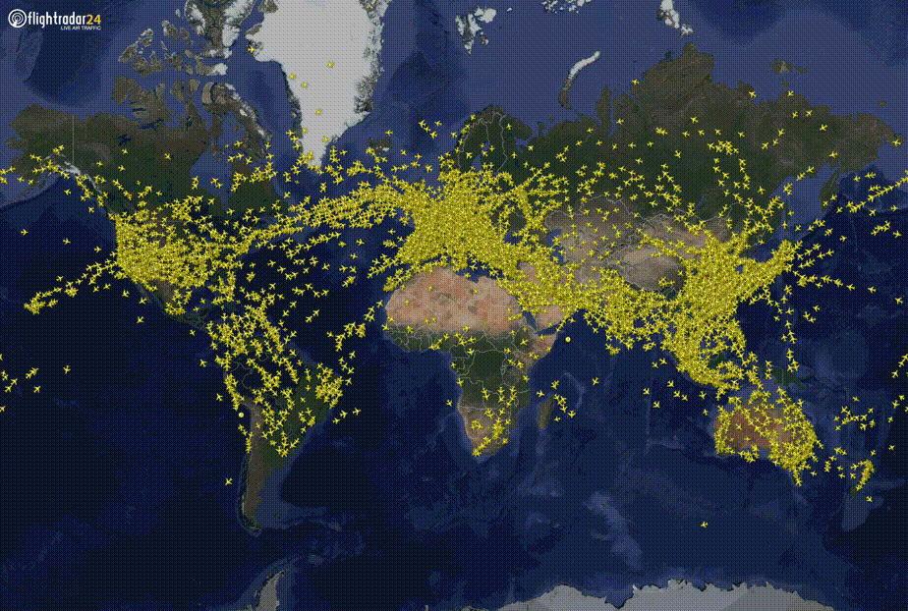

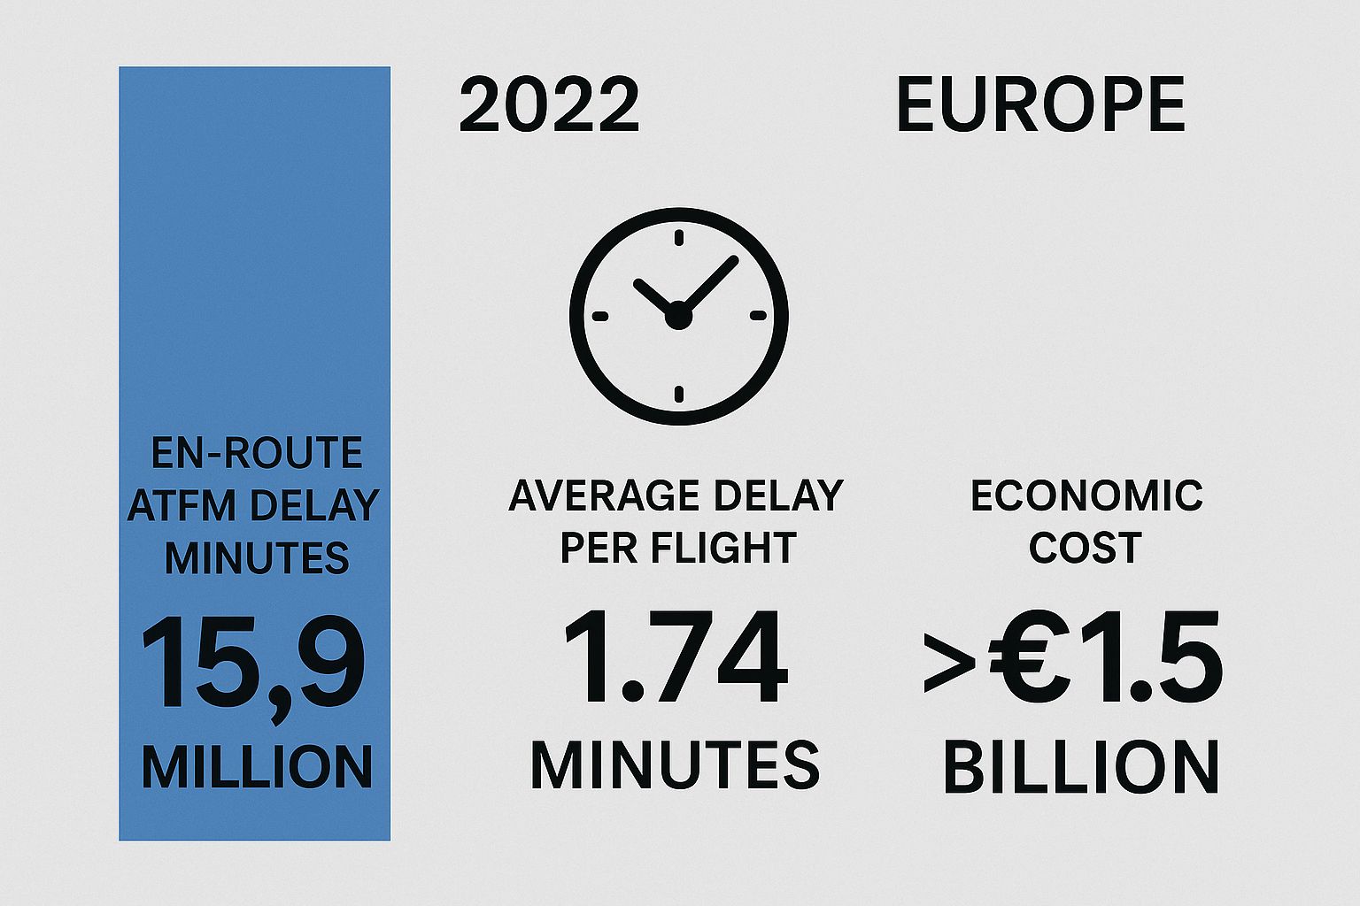
1、Background and Significance
With the continuous growth of global air transport demand, the complexity of airspace operations and flight density have increased significantly. This trend presents unprecedented challenges for air traffic control systems. As a critical component in ensuring flight safety and airspace efficiency, air traffic control faces tremendous pressure—not only in coordinating a large number of flights, but also in managing uncertainties such as sudden weather changes and potential flight conflicts.
Air traffic control is closely tied to our daily lives. From air cargo in e-commerce logistics to our routine travel and business trips, the punctuality and safety of flights directly impact the efficiency and experience of air travel. According to data, in 2022, Europe experienced a total of 15.9 million minutes of delay due to inadequate air traffic flow management, with an average delay of 1.74 minutes per flight, resulting in over €1.5 billion in economic losses.
Global Flight Movements
EUROCONTROL Data
Flight Delay

Slide 4

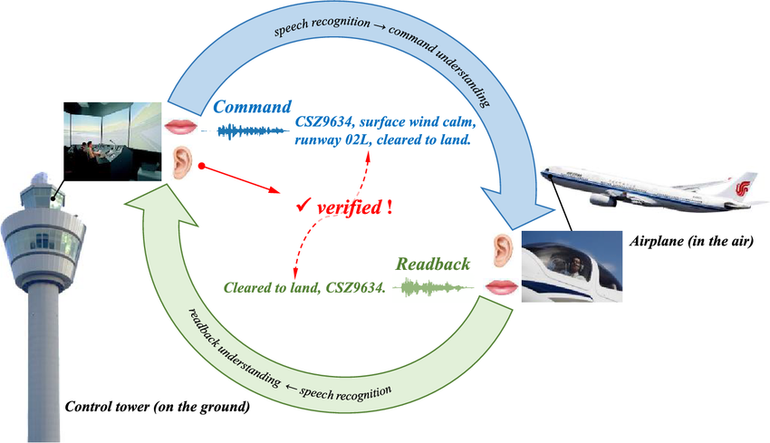
Air Traffic Controllers (ATCOs）
As the core decision-makers within the system, ATCOs are responsible for monitoring aircraft in flight, perceiving complex airspace situations, tracking aircraft dynamics and flight plans, and issuing precise maneuver command to ensure safe operations.
With the surge in flight volume, ATCOs are experiencing increasing levels of information load, psychological pressure, and operational intensity. From a human-centered perspective, this "human factor bottleneck" has become a key constraint on further improvements in the efficiency and safety of air traffic management. How to scientifically quantify task intensity, accurately assess ATCO workload, and ultimately support fatigue detection and human resource scheduling has become a critical research direction for advancing the intelligence level of air traffic control systems.
Verification Mechanism in ATCO Voice Communication
In actual operations, communication between ATCOs and pilots follows a strict "call-and-response" pattern, as shown in the diagram:
1、The ATCO issues a command from the control tower.
2、The pilot reads back the received command.
3、The ATCO verifies that the readback matches the original command in meaning.

Slide 5
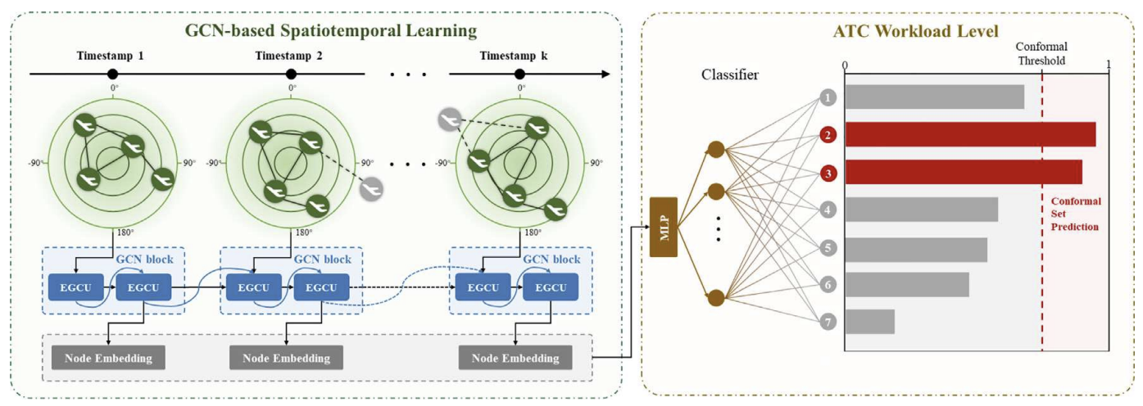
Current research in air traffic management mainly focuses on modeling flight behavior, such as trajectory prediction, landing time estimation, and flight scheduling optimization. In contrast, studies on ATCO behavior remain limited. Traditional workload assessment methods often rely on static questionnaires or psychological experiments, lacking an end-to-end framework for workload quantification.
In recent years, some machine learning approaches have emerged, using diverse data sources to predict ATCO workload, such as human-in-the-loop simulations, historical radar and sector data, and physiological or behavioral signals. However, most of these methods rely on handcrafted features and focus on workload classification or scoring, without direct links to actual flight trajectories or effective use of airspace context.
This study shifts the focus to predicting ATCO voice commands—to our knowledge, the first attempt to infer command behavior from multimodal data such as flight trajectories. We introduce the concept of the ATCO command lifecycle and accurately predict two key timing variables: the Time Offset between the command and the corresponding aircraft maneuver, and the Duration of the command. Together, these help reconstruct the ATCO’s real-time operational timeline.

Slide 6

Estimation and Scheduling of ATCO Staffing Needs
Workload Quantification and Fatigue Detection
Plane 3
ATCO Audio
Duration3
Duration1
Duration2
Duration3
Plane 2
ATCO Audio
Duration2
Metric for ATCO Workload
Plane 1
ATCO Audio
Duration1
Peak Hour…
0
Time

Slide 7
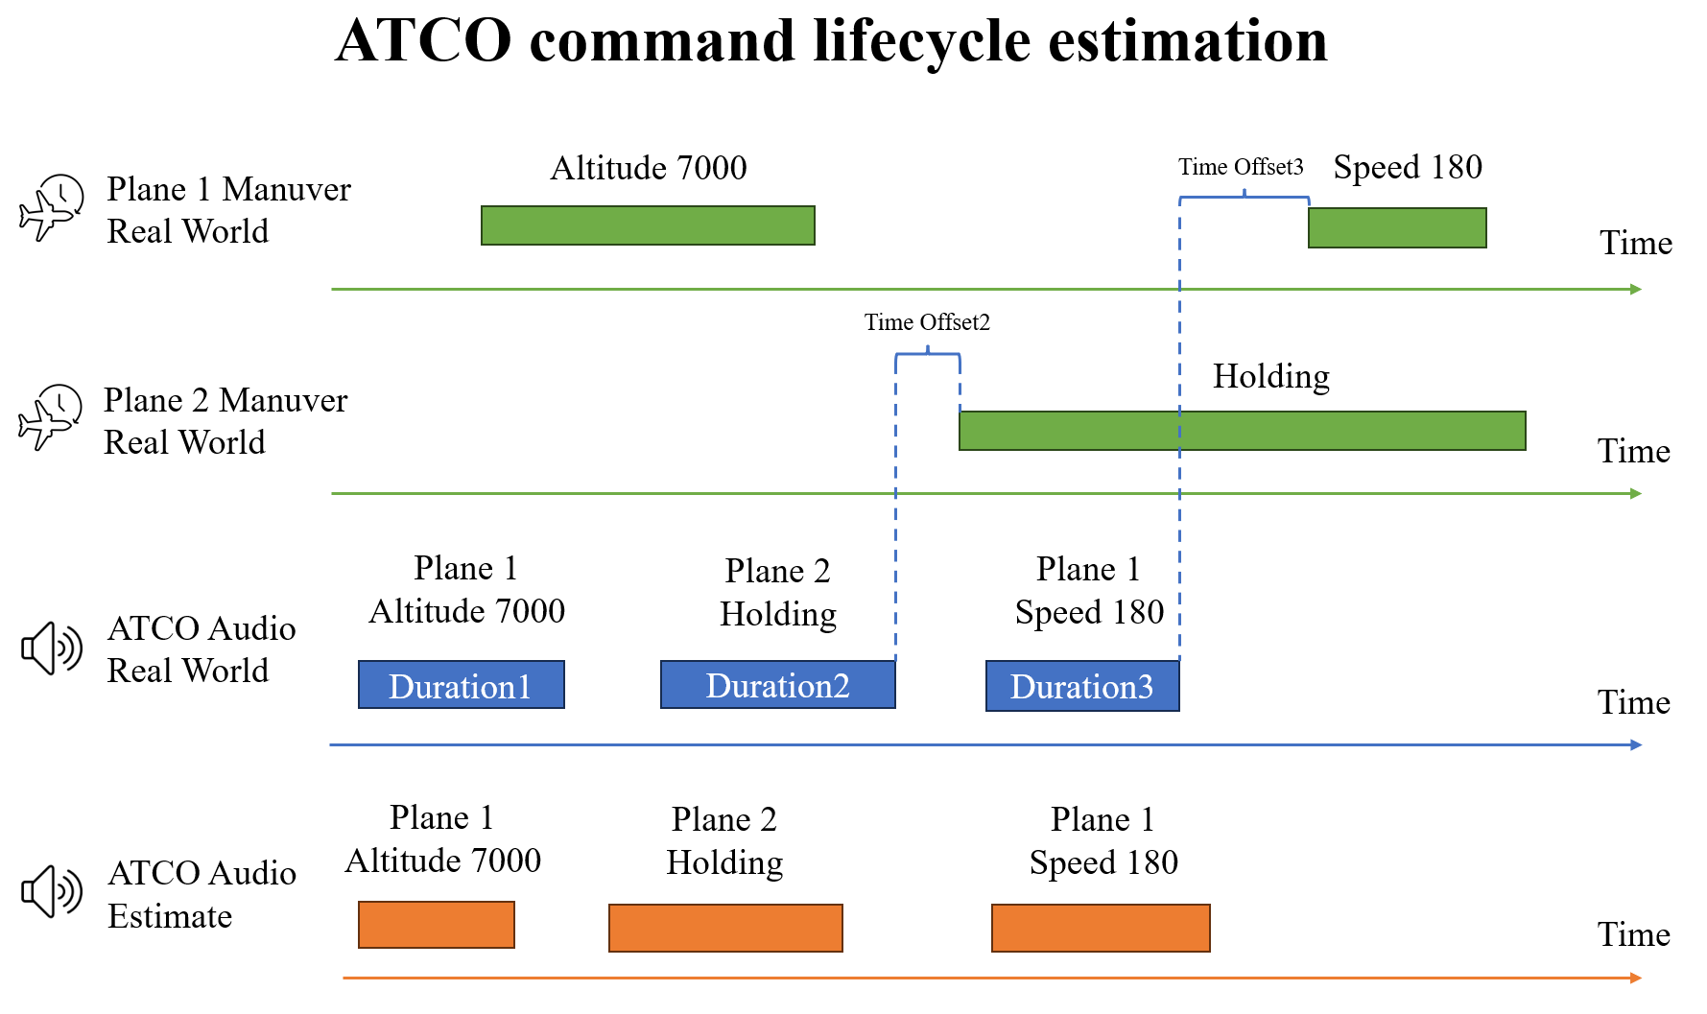
2、Prediction Objective and Framework

Slide 8

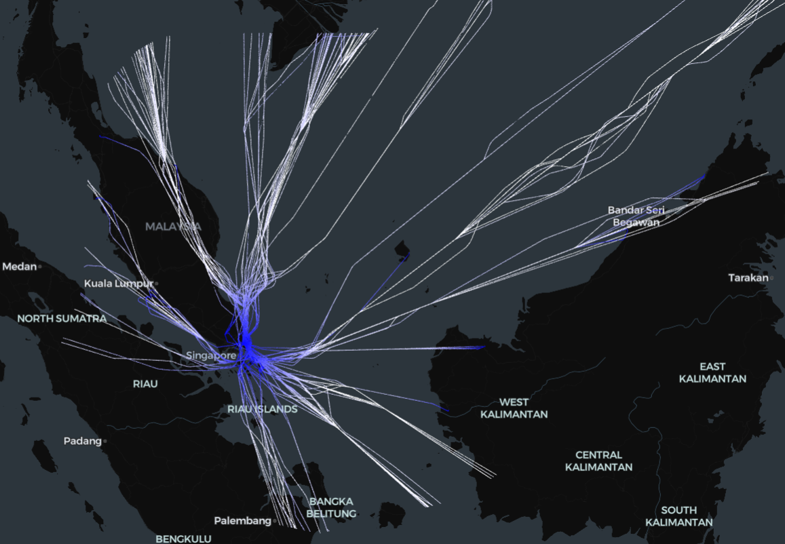

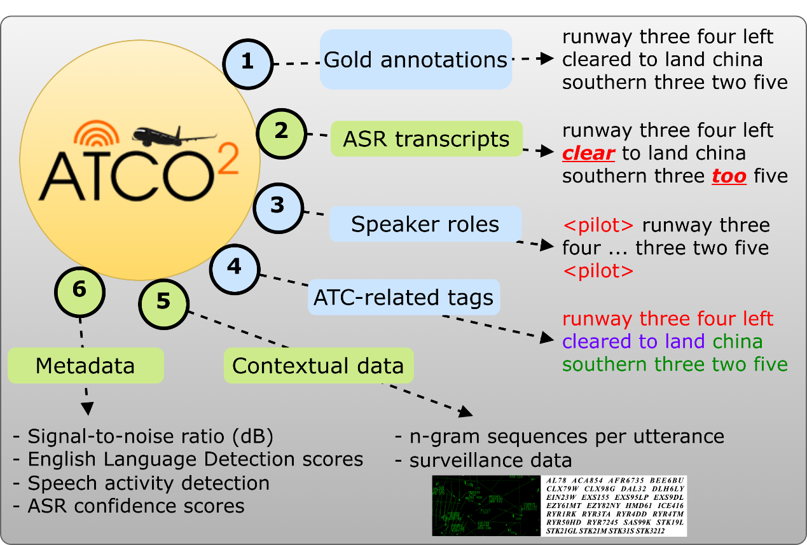
3、Multi-source Data Construction
Study Area: Changi International Airport and its Terminal Maneuvering Area
Main Data Sources: OpenSky (trajectory data) + ATCO2 (voice communication data)
Additional Data:
Weather data
Airspace structure information
Airspace situational features
Aircraft-specific characteristics

Slide 9
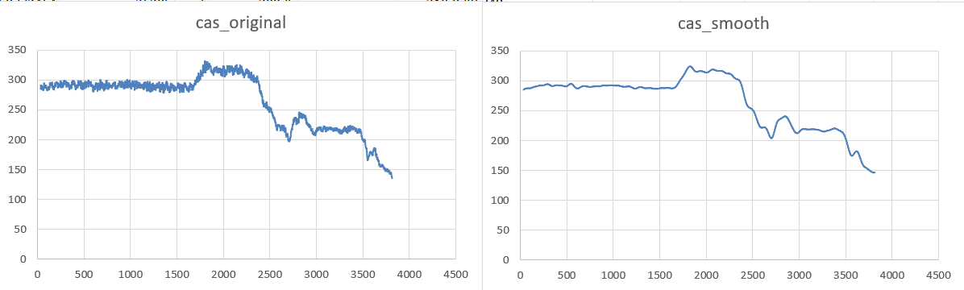
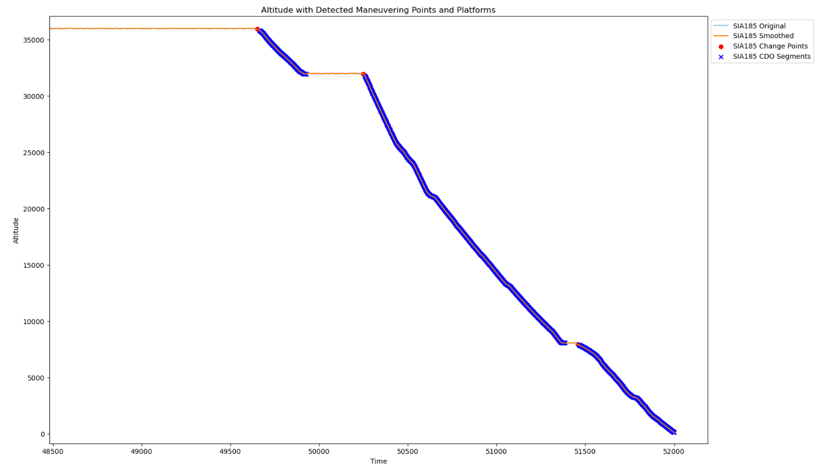
Voice Command Text Processing
1、Call Sign Recognition and Parsing
Example raw text: “speedbird one two three turn left heading zero”
Extracted call sign: BAW123
2、Command Type and Parameter Extraction
Altitude command: e.g., “descend to 3000”
Speed command: e.g., “reduce speed to 210”
Heading command: e.g., “turn left heading 180
Speed Denoising Effect Comparison
Trajectory Data Processing
To align ATCO voice commands with actual aircraft maneuvers, it is necessary to detect the precise execution time of each maneuver in the trajectory data.
Based on flight dynamics, a trajectory can be divided into:
Stable phases, where the aircraft maintains constant parameters—typically before any new command is given.
Transition phases, where the aircraft responds to a command by adjusting its flight state (e.g., altitude, heading, or speed).
Core approach: a combination of filters, sliding windows, and histogram-based platform detection.
Altitude Change Detection (Red dots indicate detected maneuver points)

Slide 10
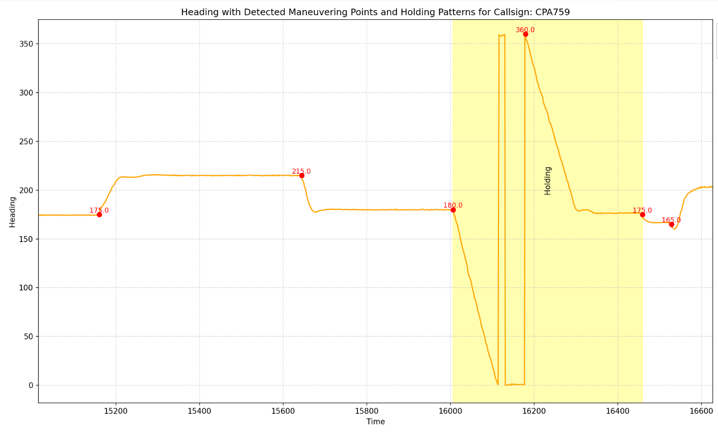
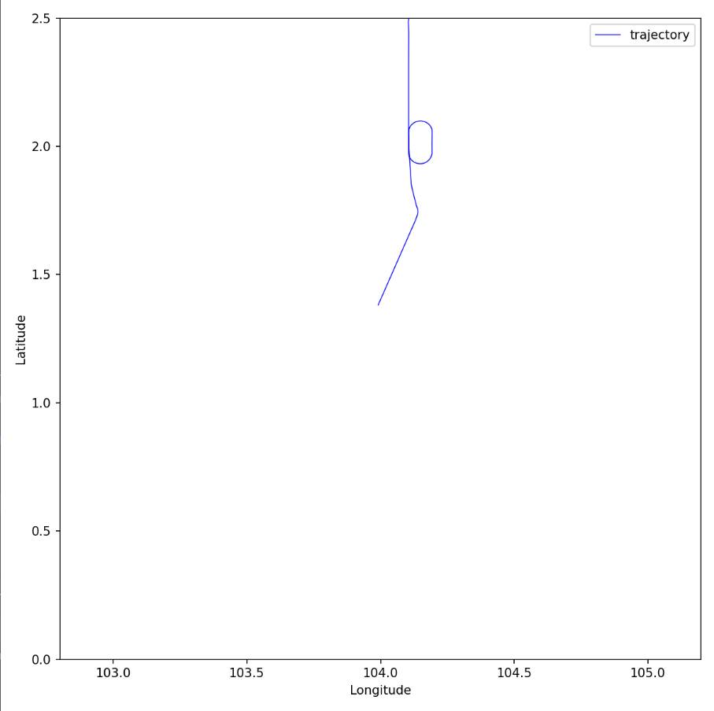
Holding Pattern Detection: To distinguish holding patterns from ordinary heading changes, thereby improving model accuracy.
Heading changes and holding detection for CPA759 (red = heading change, yellow = holding)
Trajectory visualization with holding region (ellipse)

Slide 11

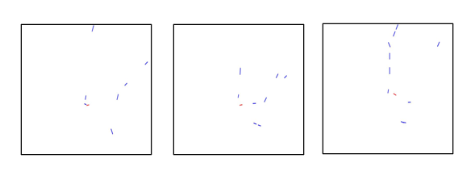
Image Generation
To enhance the model’s understanding of aircraft behavior within the airspace context, two types of image inputs were constructed in this study.
The first type of image captures the historical trajectory of the target flight. For each command timestamp, a two-minute trajectory segment preceding the command is extracted and rendered as a blue path image without coordinate axes. The image dimensions and geographical bounds are standardized to ensure spatial consistency across samples.
The second type of image reflects the multi-aircraft situation at the moment a command is issued. It includes the positions, headings, and airspeeds of all aircraft at that time. Velocity vectors are drawn for each aircraft, with color coding: the commanded aircraft is shown in red, while all others are shown in blue.
Sample images of generated historical trajectories
Sample images of generated airspace snapshots

Slide 12
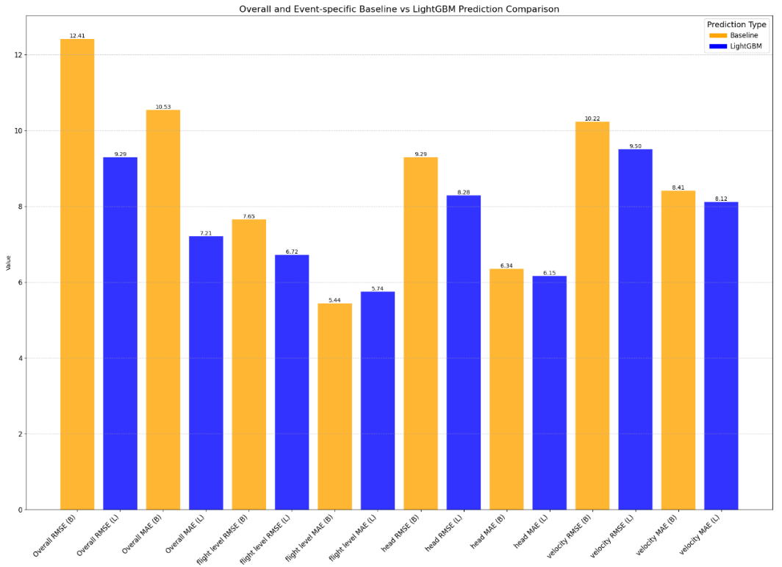
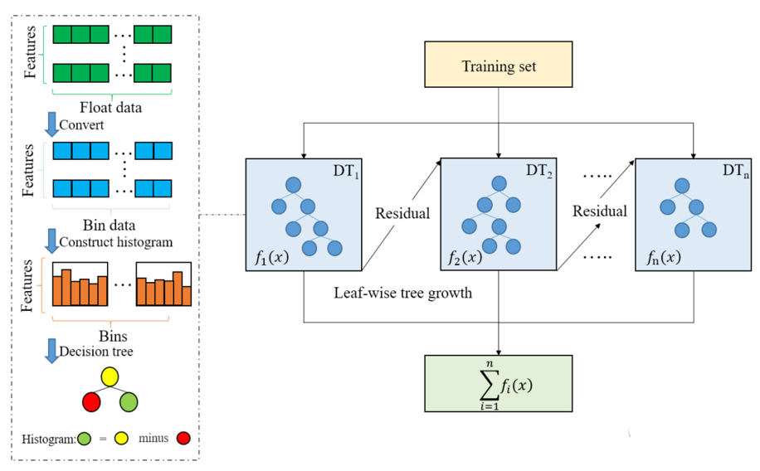
Preliminary Experiment — LightGBM Baseline Model
Overall, LightGBM outperformed the mean-value baseline, confirming that the time offset is a predictable target.
LightGBM (Light Gradient Boosting Machine) is an efficient gradient boosting framework designed for large-scale data and high-performance training.
This experiment aims to build an interpretable regression model to evaluate the predictability of the time offset between aircraft maneuvers and ATCO commands. In addition, feature importance scores are extracted to inform feature selection for the subsequent CNN-Transformer model. A subset of structured variables from the dataset was used as model input.

Slide 13
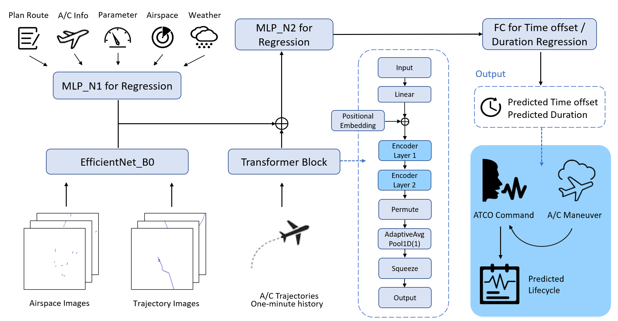
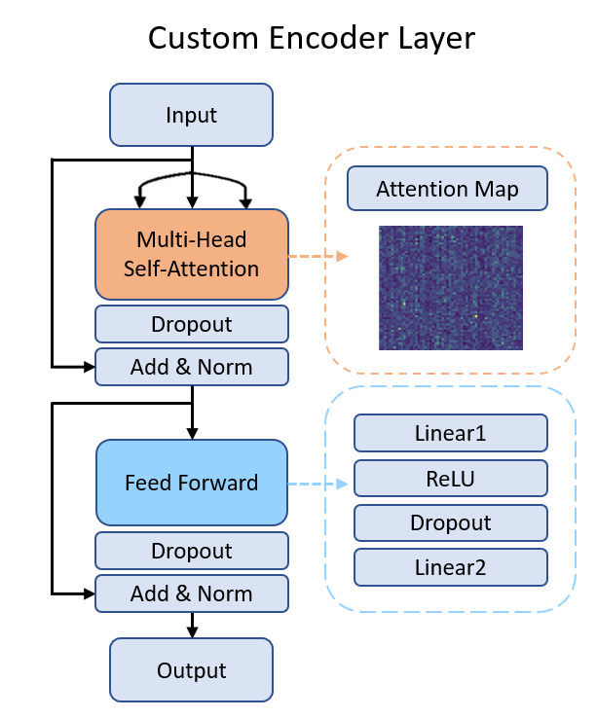
4、Model Design and Experiments
CNN-Transformer Model Architecture: The model jointly learns from structured features, historical trajectory sequences, and image-based airspace context to predict two key variables in the ATCO command lifecycle——time offset and duration.

Slide 14
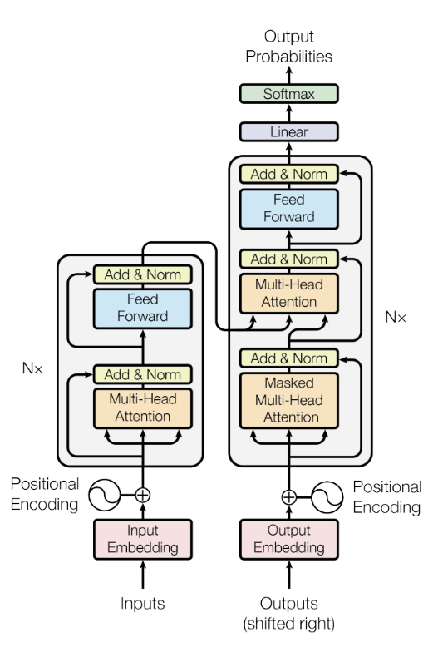
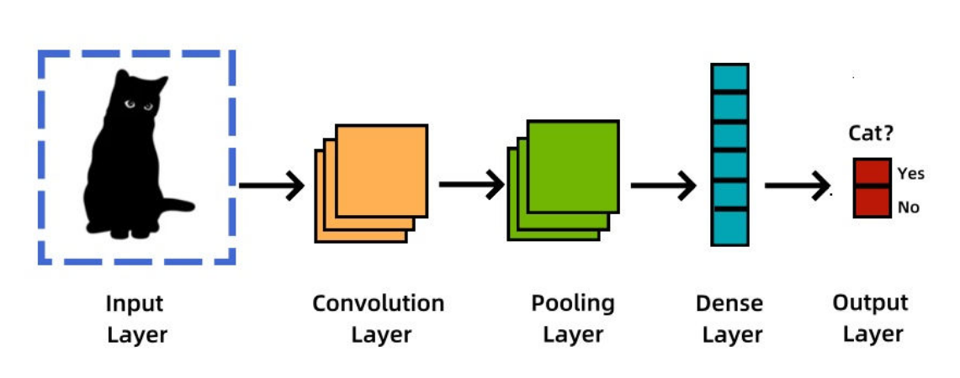
Model Design Considerations
Flight trajectory data inherently contain both spatial patterns and temporal dynamics. Traditional models often struggle to effectively capture both aspects simultaneously, calling for a hybrid architecture that can model spatial structures as well as temporal dependencies.
CNN is used to extract spatial features from image inputs.
Transformer is employed to capture temporal dependencies within trajectory sequences.

Slide 15
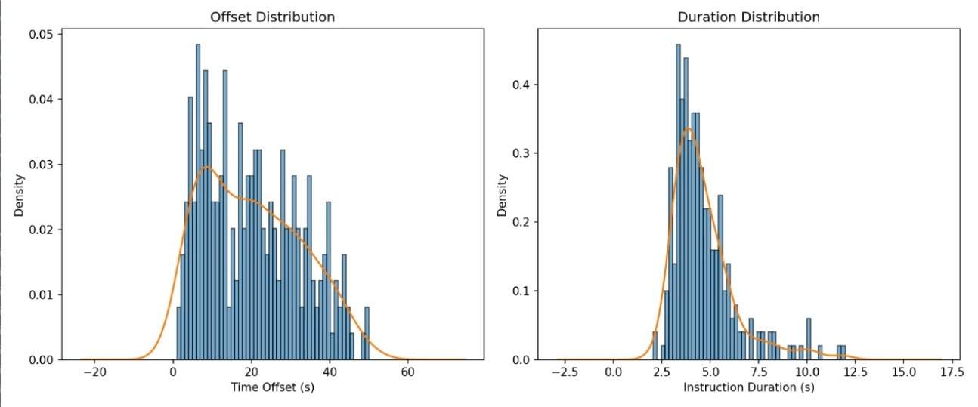
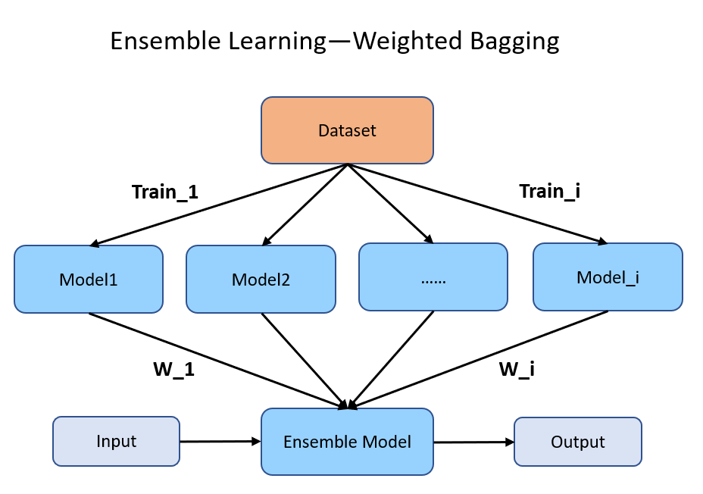
Regression Label Distribution
During model training, multiple model variants were built using different loss functions and random seeds. The choice of loss function was guided by the distribution characteristics of the target labels.
To enhance robustness and generalization, a weighted ensemble learning strategy was adopted after training. Specifically, for each of the two loss functions, the best-performing models on the validation set were selected across three categories: time offset, duration, and overall. Two top models were chosen per category, resulting in a total of 12 representative checkpoints.
Predictions from these models on the test set were combined using a weighted average. The weights were assigned based on task priority:
For time offset ensemble, the offset-optimal models were given a weight of 0.5, overall-optimal models 0.3, and others 0.1.
The same weighting scheme was applied for duration ensemble.
This strategy maintained low prediction errors while improving the model's adaptability to varying data distributions.
Weighted model ensemble strategy

Slide 16
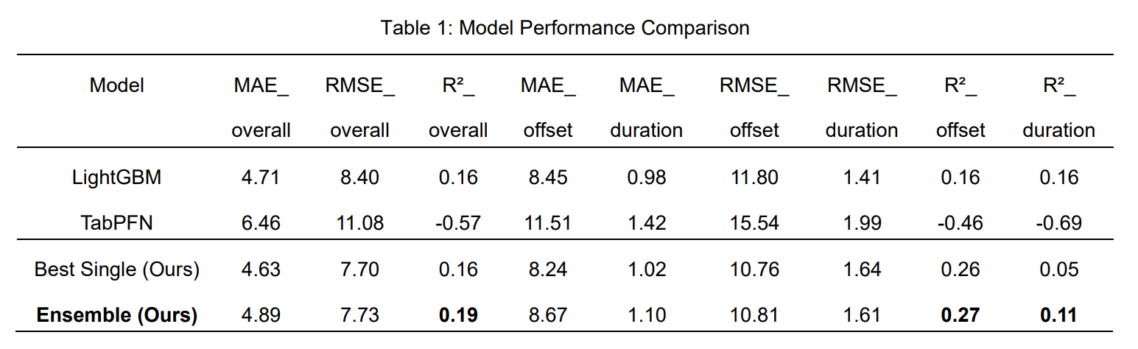
A comparison of multiple models was conducted to evaluate their performance in predicting the ATCO command lifecycle. Based on both overall metrics and task-specific indicators for the two key sub-tasks, results show that the ensemble learning model achieved the highest overall R² of 0.19, significantly outperforming other approaches. This demonstrates its stronger fitting ability and generalization performance.

Slide 17
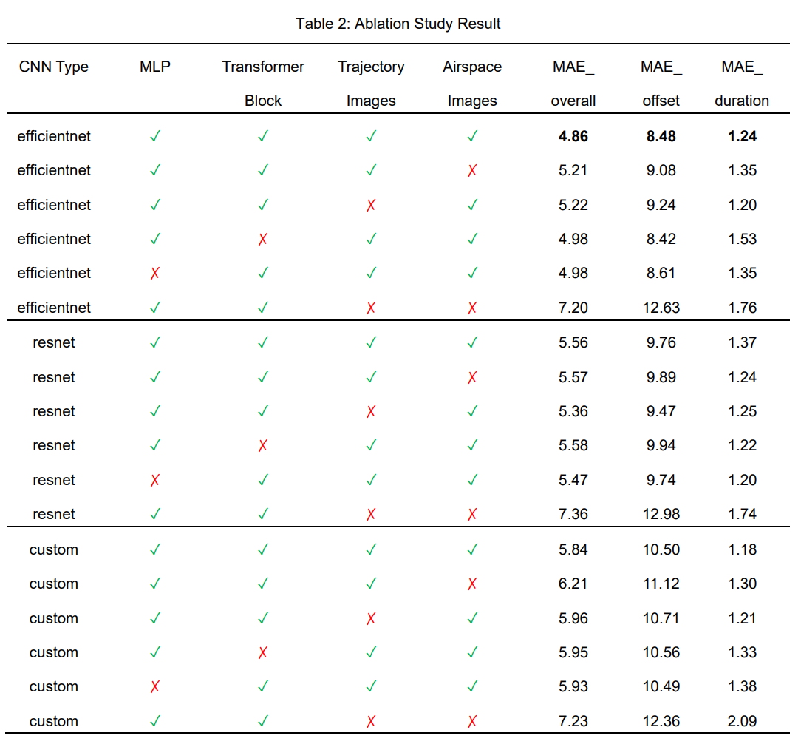
Furthermore, removing any single input branch led to a drop in prediction accuracy, confirming the necessity of the multimodal fusion design proposed in this study.

Slide 18
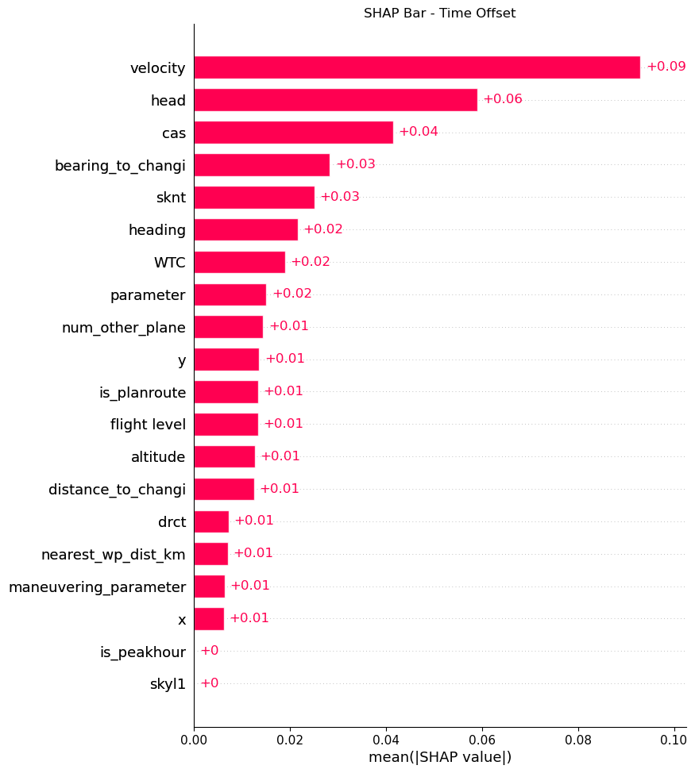
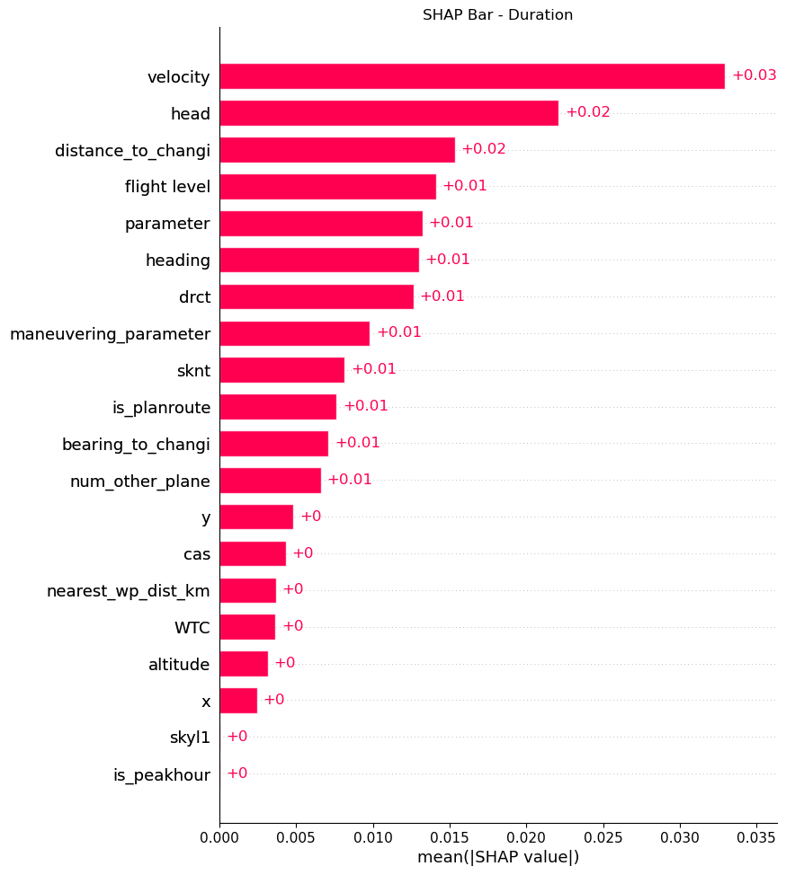
Interpretability Analysis — Structured Data (SHAP Feature Bar Plot)

Slide 19
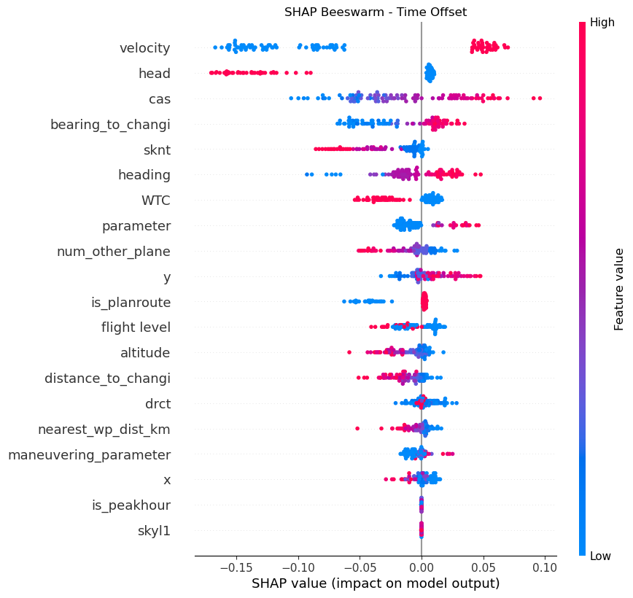
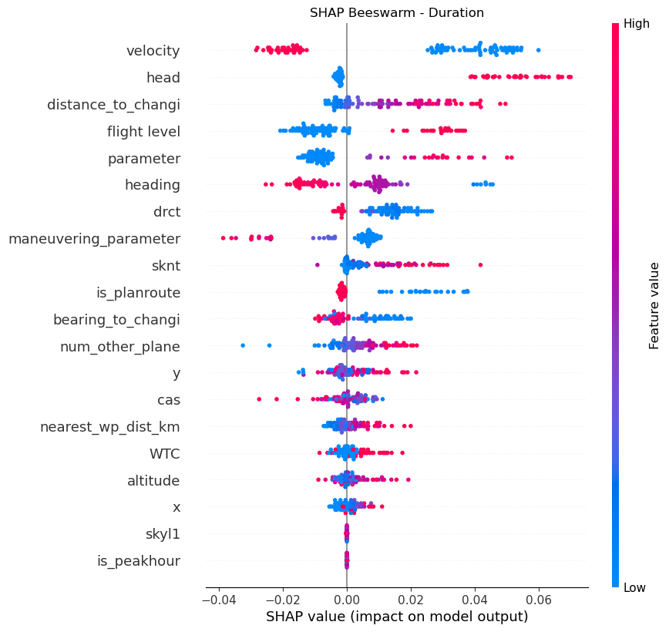
Interpretability Analysis — Structured Data (SHAP Feature Beeswarm Plot)

Slide 20
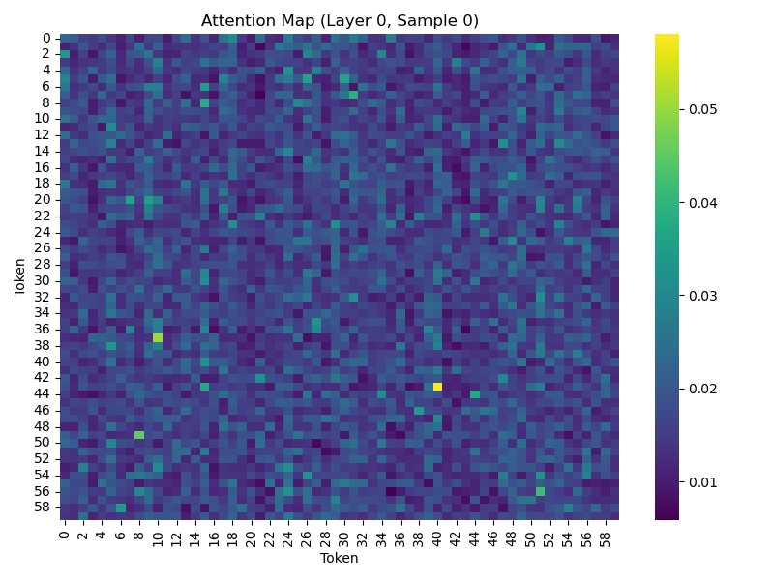
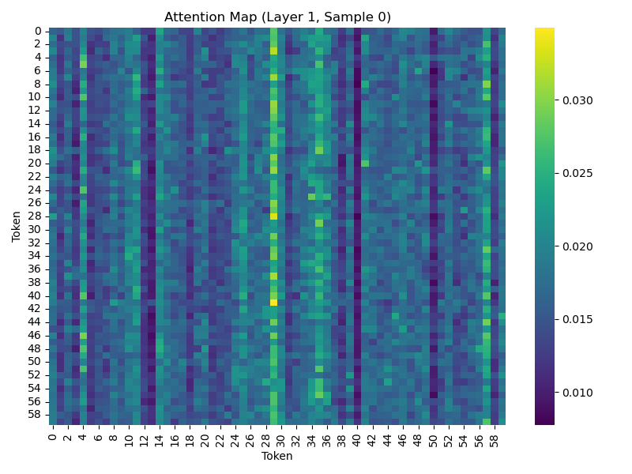
Interpretability Analysis — Trajectory Input (Attention Heatmap)
Based on the attention weight matrices from the custom Transformer module, the attention relationships between time steps in the input sequence were visualized.
Encoder Layer 1
Encoder Layer 2
The attention weights in the first layer are generally dispersed, indicating that the shallow layers are still capturing information and extracting coarse-grained features, without yet learning stable temporal dependencies.
The second layer attention heatmap gradually shows vertical stripe patterns, where certain time steps (e.g., columns 4, 29, 35, 57) become focal points attended to by many others. This implies that deeper layers can identify and focus on key moments in the historical trajectory.

Slide 21
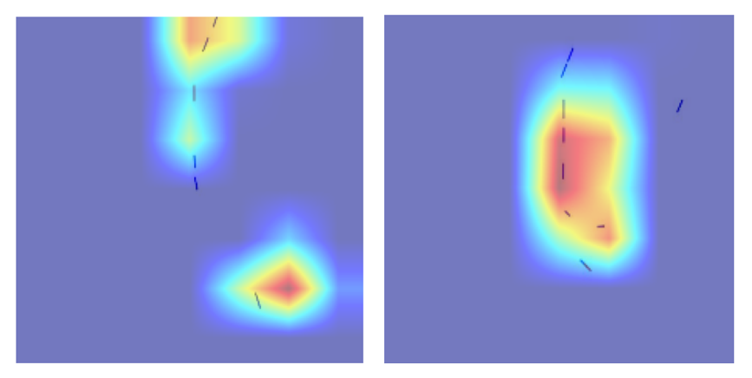
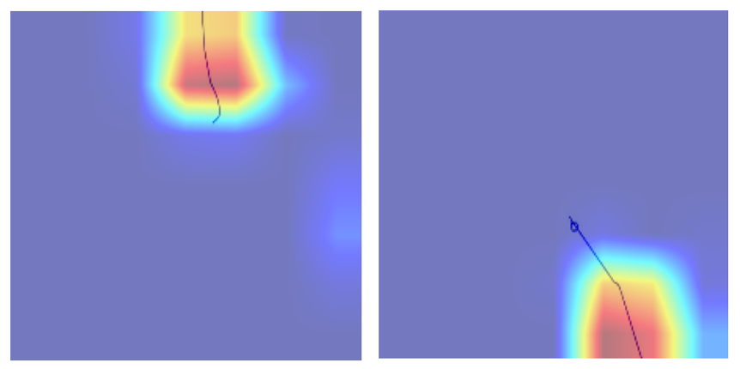
Interpretability Analysis — Image Input (Grad-CAM Heatmap)
For the two image input branches, Grad-CAM (Gradient-weighted Class Activation Mapping) was applied to visualize spatial attention regions in the CNN feature maps, revealing the basis of model decisions on image data.
The left heatmap shows the Grad-CAM result on the current airspace situation image, with hot regions concentrated in dense areas of other traffic activities. The model tends to focus on congested zones or regions with high conflict risk.
The right heatmap displays Grad-CAM results on the historical trajectory image, with hot regions centered around points where the aircraft is about to or currently making heading or speed adjustments, especially near historical maneuver points.

Slide 22
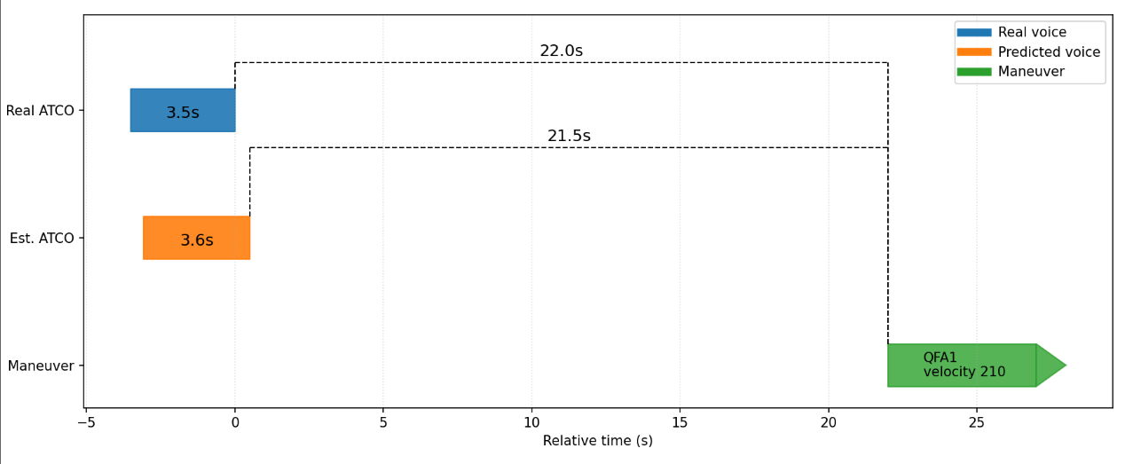
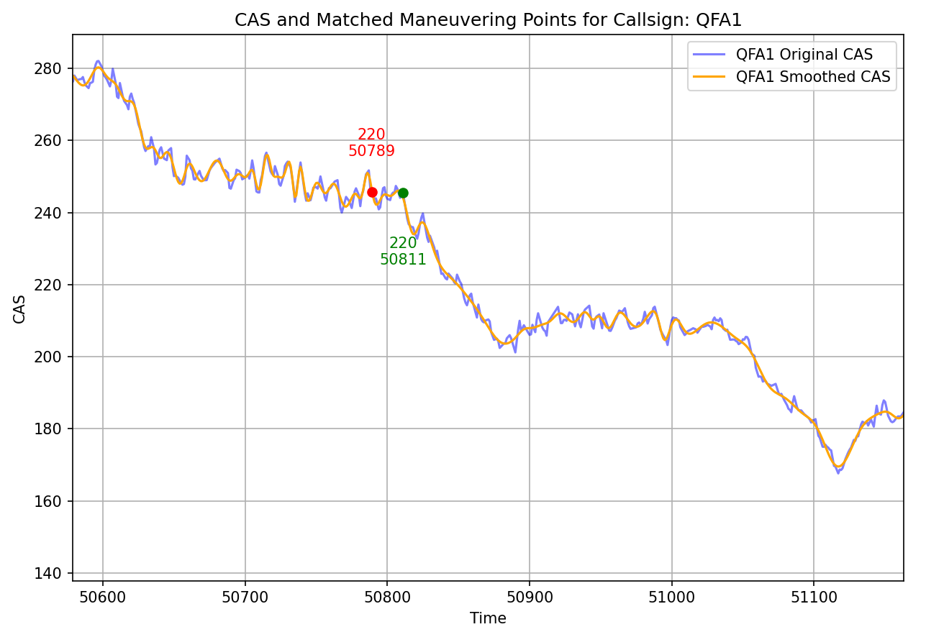
Case Study——Single Command Prediction
A typical prediction example was selected using flight QFA1 to illustrate the speed parameter changes. Around 50,789 seconds, the ATCO issued a command to reduce the aircraft speed from 250 knots to 220 knots. At approximately 50,811 seconds, the model successfully identified a corresponding speed maneuver. In the figure, red dots mark the actual command issuance times, while green dots indicate the actual maneuver times.
Visualization of the predicted command lifecycle
A timeline visualization of the command lifecycle prediction is shown, including the real voice command (blue), the model-predicted command timing (yellow), and the actual maneuver (green). The model’s inferred temporal relationships closely match the real sequence.
In this example, the predicted command duration differs from the actual voice command by only 0.1 seconds, demonstrating the model’s strong ability to learn ATCO behavioral patterns.

Slide 23
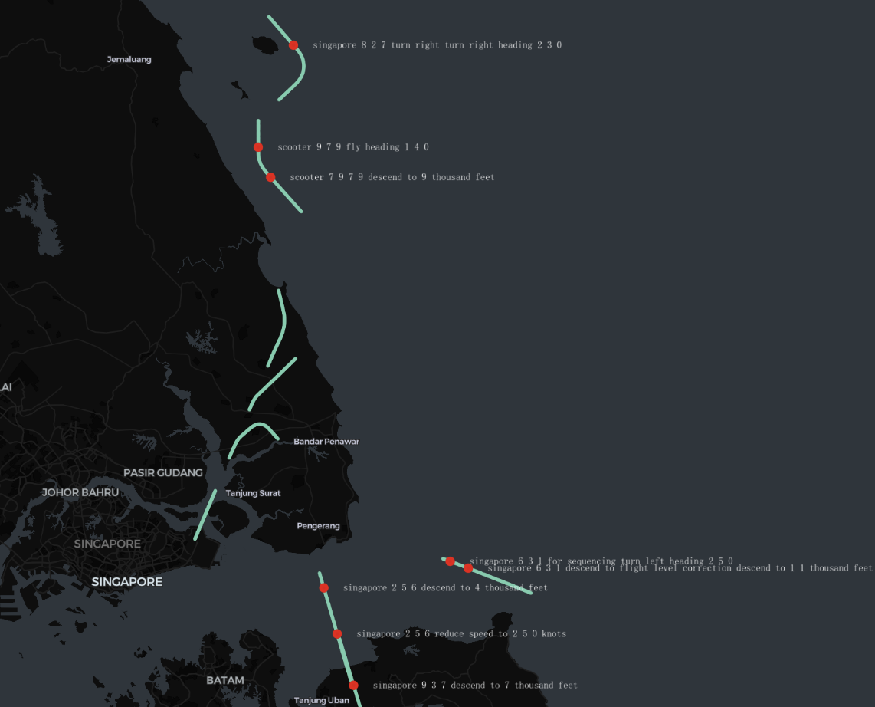
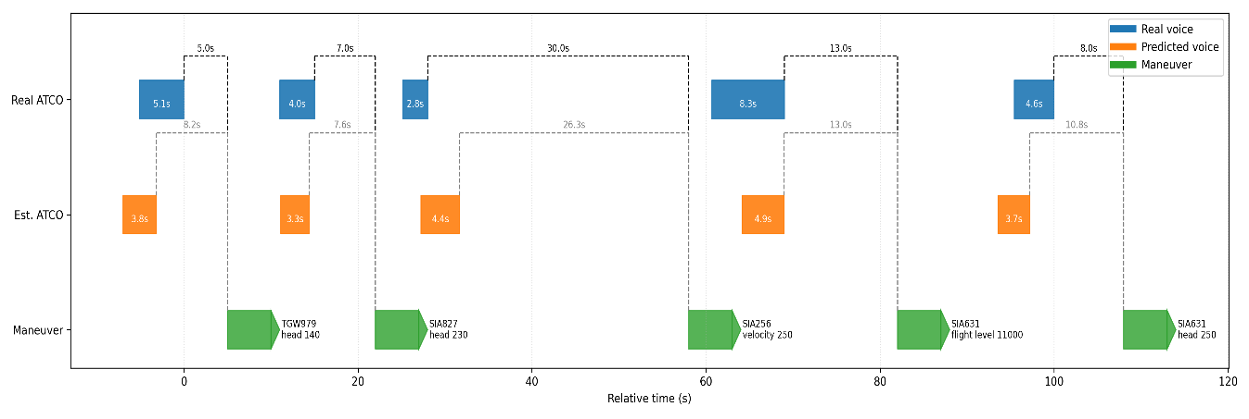
Case Study——Multi-Command Prediction
To verify the model’s generalization in multi-target, high-density command scenarios, a 100-second continuous high workload segment in the terminal airspace (23,288–23,388 seconds) was selected.
The right figure shows the airspace trajectory map during this period, with green lines representing flight paths and red dots indicating ATCO voice command events. Multiple command tasks are densely distributed along adjacent flight routes, reflecting a significantly increased ATCO workload.
The lower figure illustrates that the model successfully reconstructed the command lifecycles of multiple flights within this time window, including TGW979 (heading 140), SIA827 (heading 230), SIA256 (velocity 250), and SIA631 (flight level 11,000, heading 250).
Even in scenarios with continuous command issuance, the model can accurately associate the timing of each voice command with the corresponding maneuver.

Slide 24
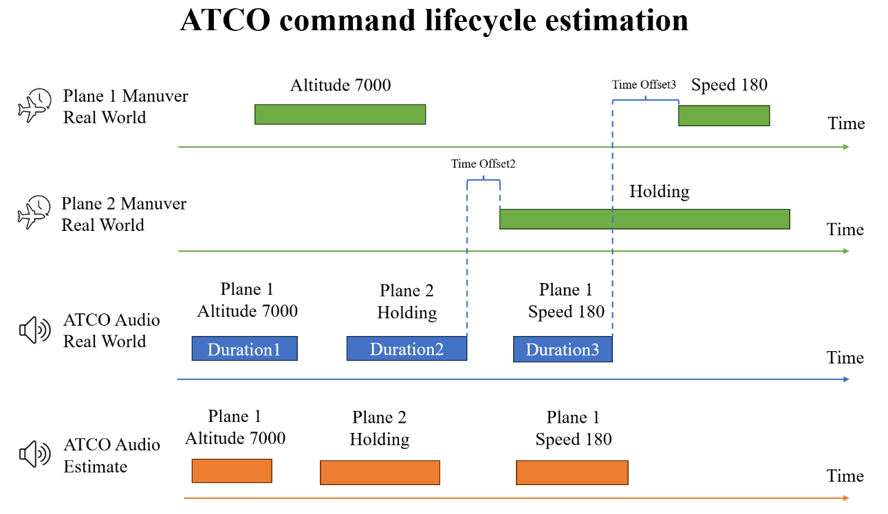
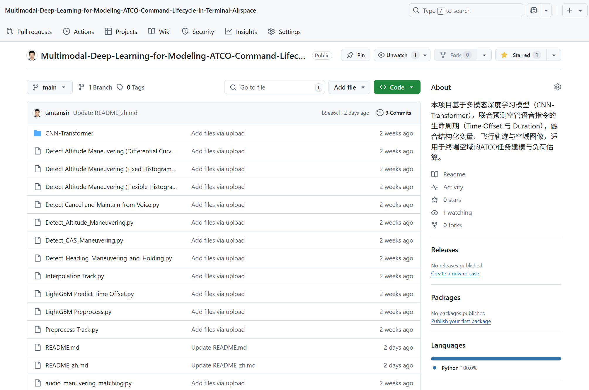
5、Conclusion
This study proposes a multimodal deep learning framework that integrates structured data, historical trajectory sequences, and image-based airspace context, focusing on two key parameters in the ATCO command lifecycle: the time offset between command issuance and aircraft maneuver, and the command duration.
A high-quality dataset was built based on flight trajectories, voice communication, and auxiliary data from the terminal maneuvering area. During preprocessing, maneuver points were accurately detected using sliding windows and histogram-based methods. A LightGBM baseline was first used to verify the predictability of the task. Then, a CNN-Transformer fusion architecture combined with ensemble learning was developed to achieve accurate prediction of command lifecycle parameters. Experimental results show that the proposed model significantly outperforms traditional approaches in both time offset and duration prediction, with strong generalization and interpretability.
By estimating these two parameters, this work presents the first model to infer voice command timing directly from flight trajectory data, enhancing the precision of intelligent command generation. The approach also provides theoretical support for workload assessment and practical tools for ATCO staffing optimization during high-demand periods.
All code modules have been open-sourced on GitHub to support academic collaboration and model reproducibility. The proposed method holds promise for future integration into airport collaborative decision-making systems.

Slide 25
Thank you!

